Slide 1
Framing Methods

Slide 2
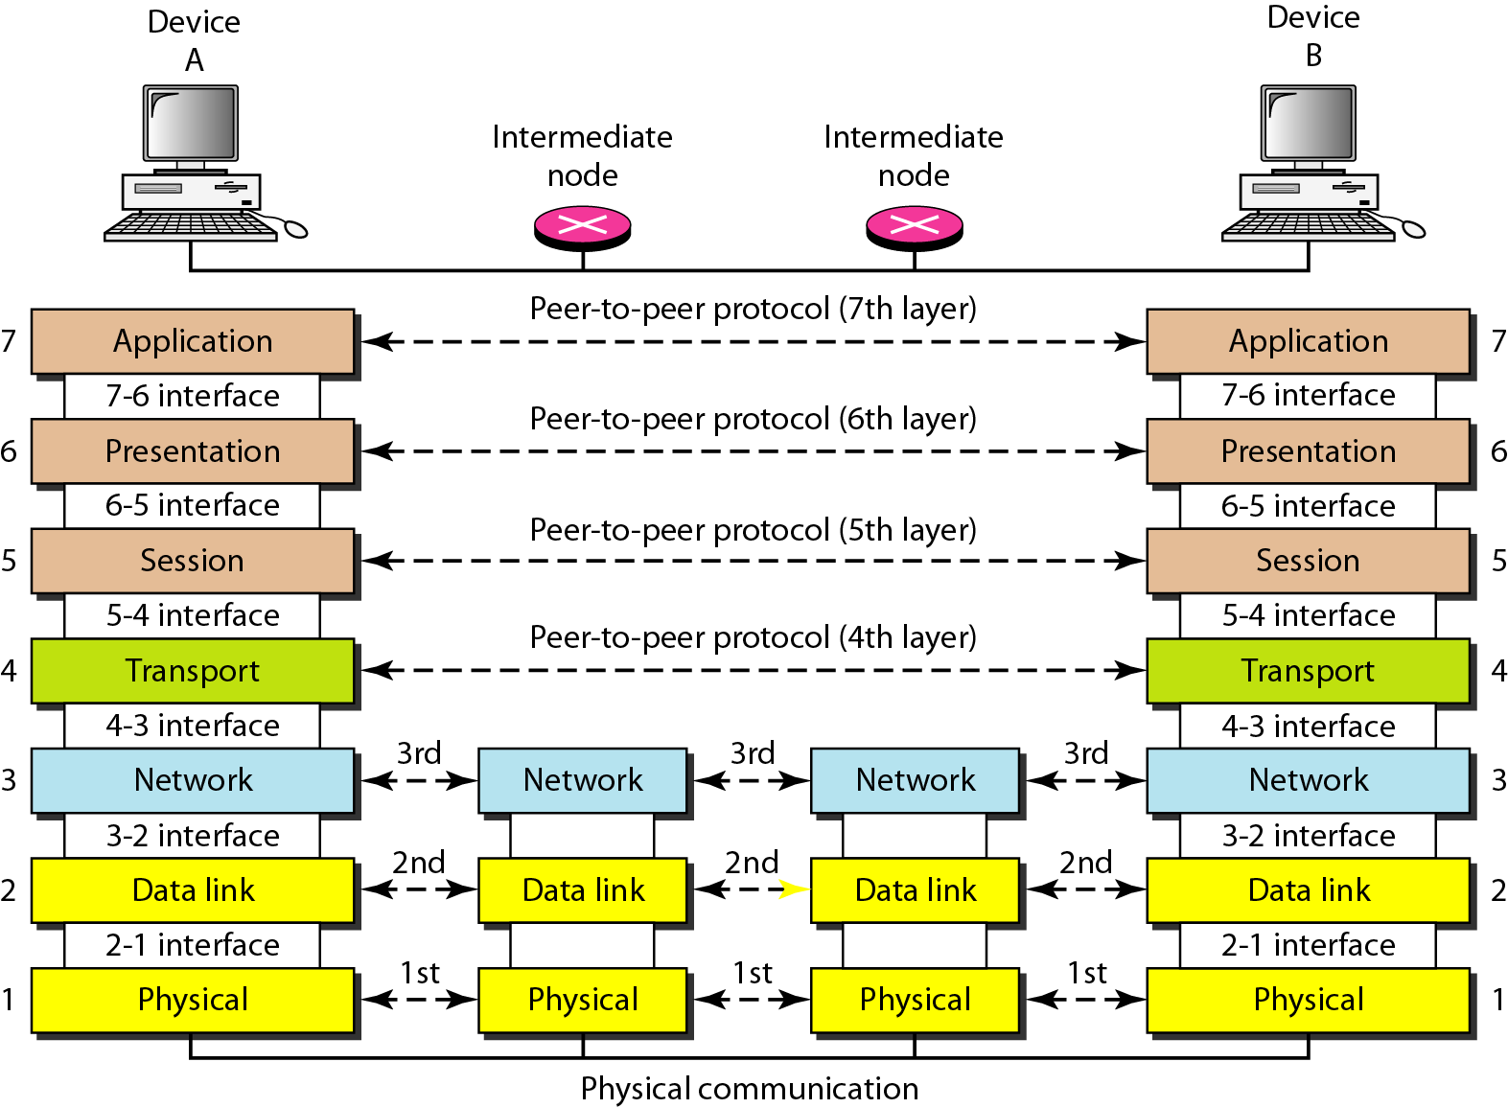
The interaction between layers in the OSI model

Slide 3
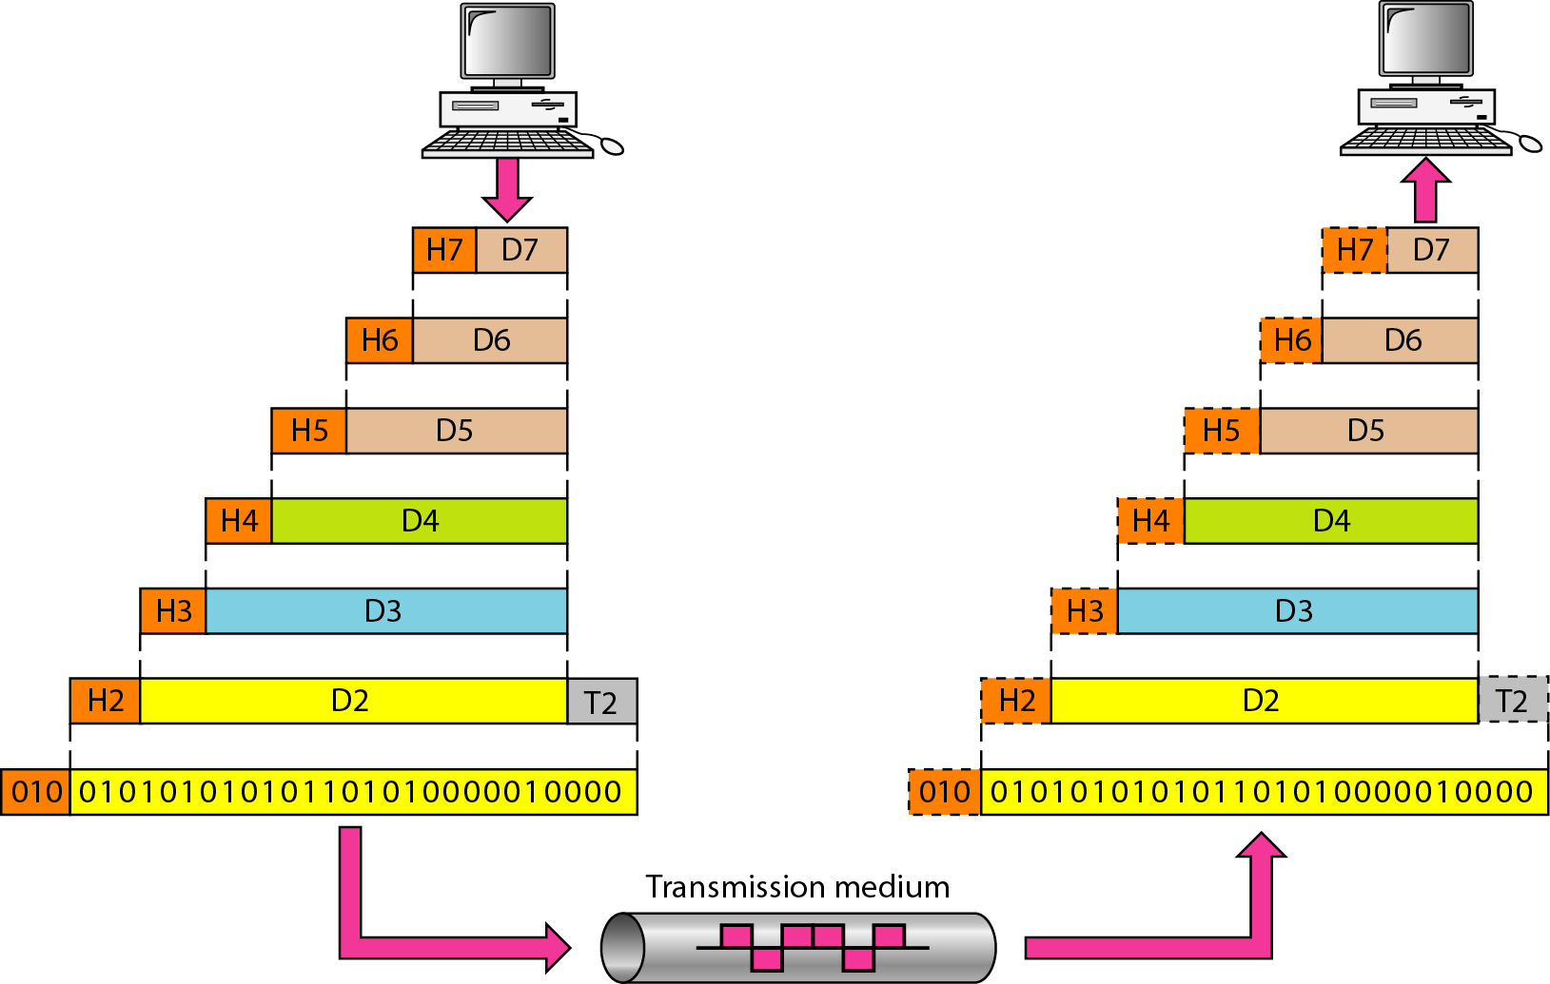
Figure 2.4 An exchange using the OSI model

Slide 4
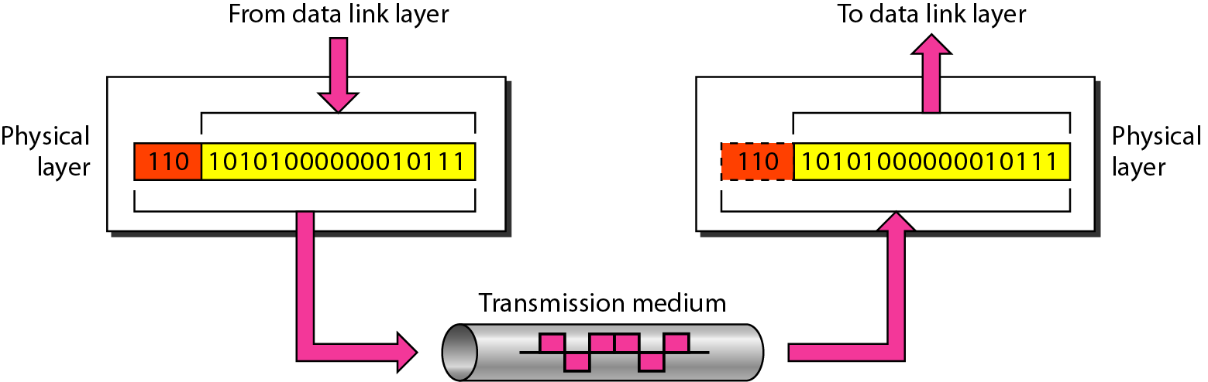
Physical layer

Slide 5

Note
The physical layer is responsible for movements of
individual bits from one hop (node) to the next.

Slide 6
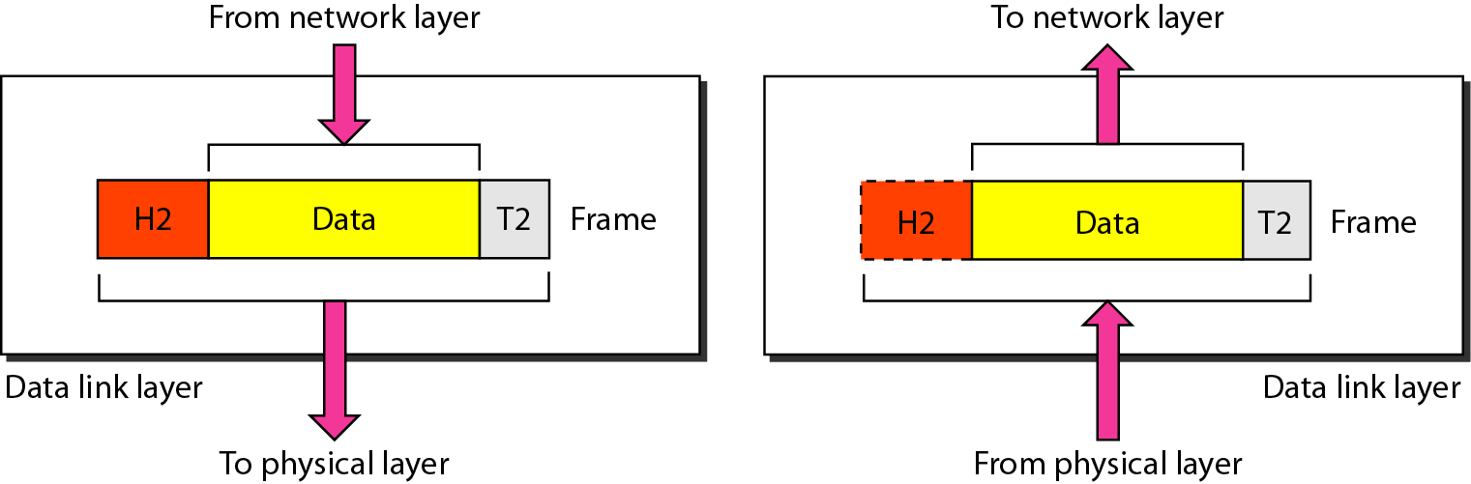
Figure 2.6 Data link layer

Slide 7
Note
The data link layer is responsible for moving frames from one hop (node) to the next.

Slide 8
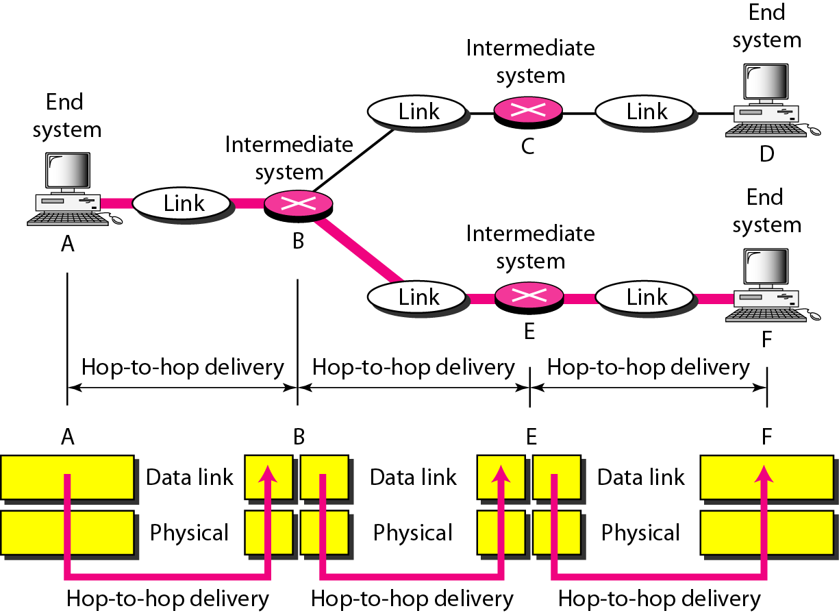
Hop-to-hop delivery

Slide 9
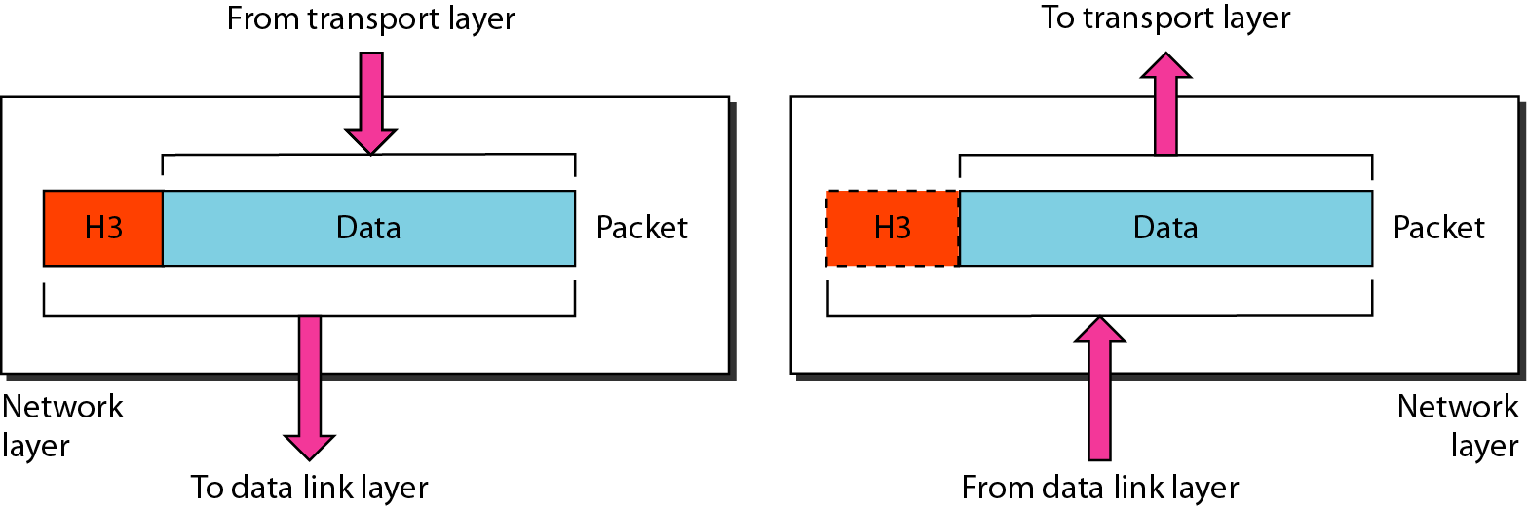
Network layer

Slide 10
Note
The network layer is responsible for the delivery of individual packets from
the source host to the destination host.

Slide 11
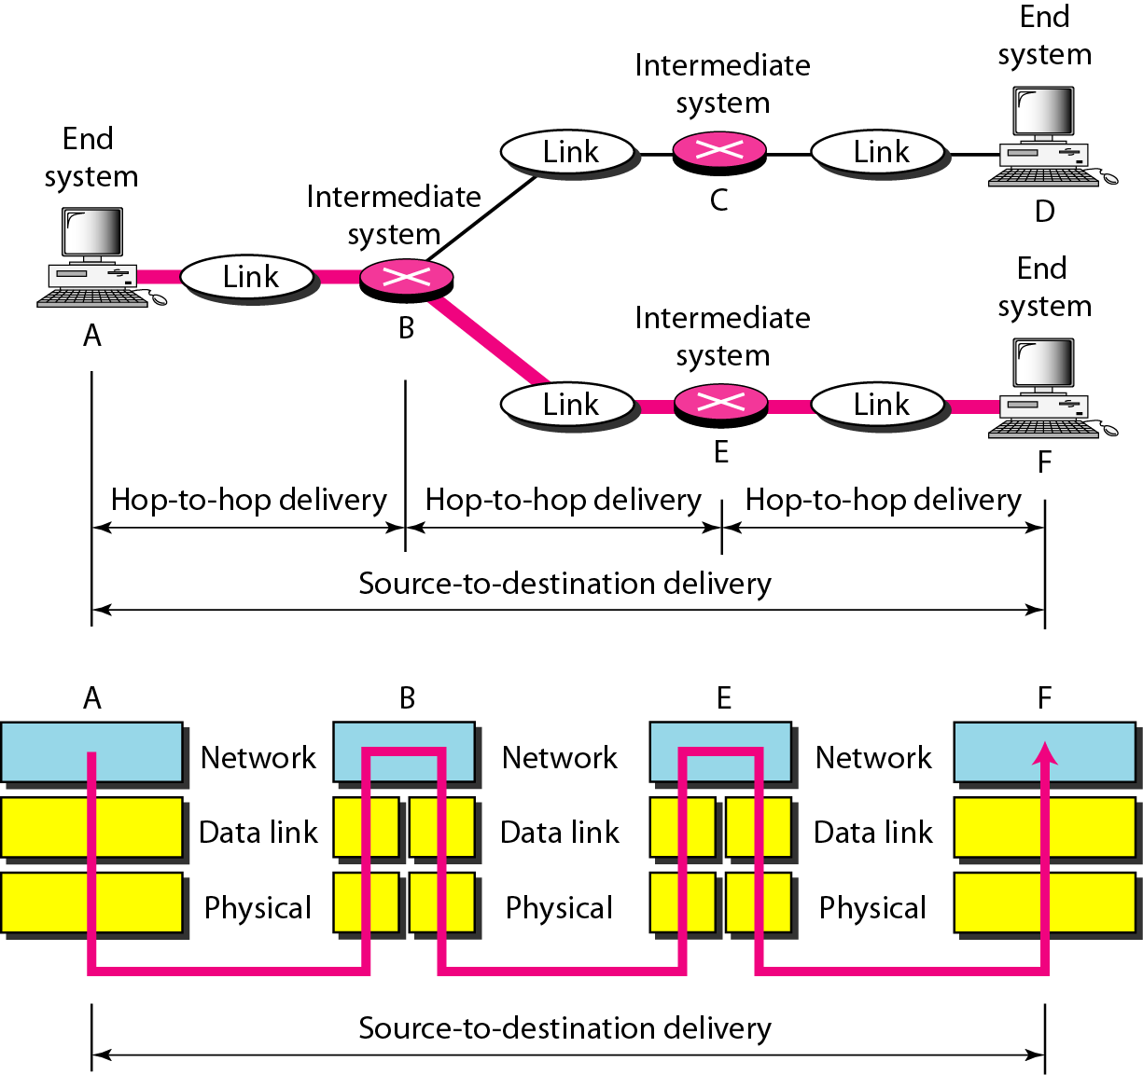
Source-to-destination delivery

Slide 12
Frames
Data-link layer takes the packets from the Network Layer and encapsulates them into frames.
Then, it sends each frame bit-by-bit on the hardware. At receiver's end, data link layer picks up signals from hardware and assembles them into frames.

Slide 13
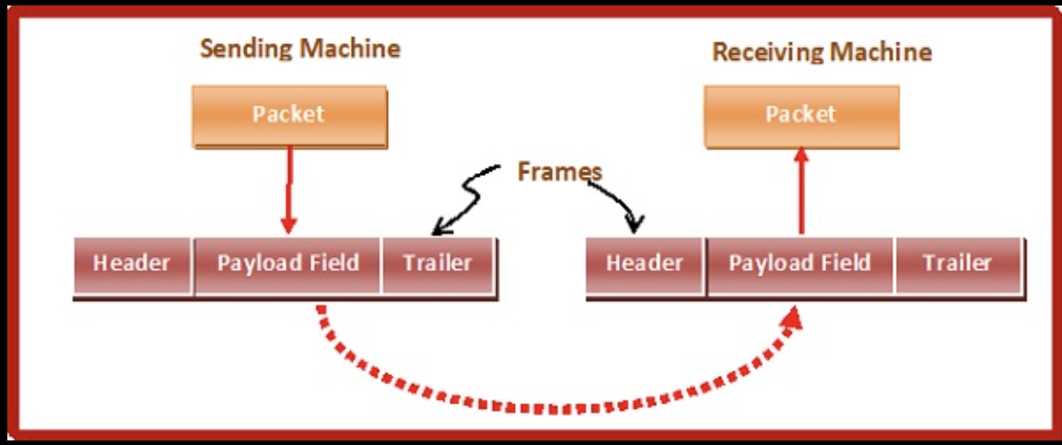
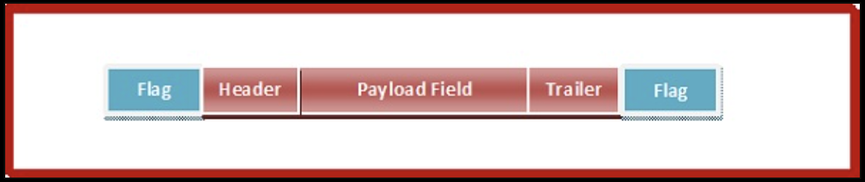
Parts of Frame
Frame Header − It contains the source and the destination addresses of the frame.
Payload field − It contains the message to be delivered.
Trailer − It contains the error detection and error correction bits.
Flag − It marks the beginning and end of the frame.

Slide 14
Delimiter
Two ways to define frame delimiters−
Length Field − Here, a length field is used that determines the size of the frame.
End Delimiter − Here, a pattern is used as a delimiter to determine the size of frame. It is used in Token Rings. If the pattern occurs in the message, then two approaches are used to avoid the situation −

Slide 15
Bit Stuffing

Slide 16
Character Stuffing

